Slide 1
How to Develop a Successful QI Project
Anu Subramony, MD, MBA
Chief Quality Officer, CCMC
VP Quality and Safety, Pediatric Service Line
Twitter #ccmcquality

Slide 2
How is QI different from research?
 | Research | Quality Improvement
Purpose | To discover new knowledge | To bring new knowledge to practice
Tests | One large “blind” test | Many sequential, observable tests
Biases | Control for as many biases as possible | Stable the biases from test to test
Data | Gather as much data as possible | Gather “just enough” data to learn and complete another cycle
Duration | Can take long periods of time | “Small tests of significant changes”

Slide 3
The Elements of a Quality Improvement Project
Project Charter and Problem Statements
Global Aim and SMART Aim
Key Driver Diagram
Data Analysis (Lite!)
PDSA Cycles
Sustainability (Lite!)

Slide 4
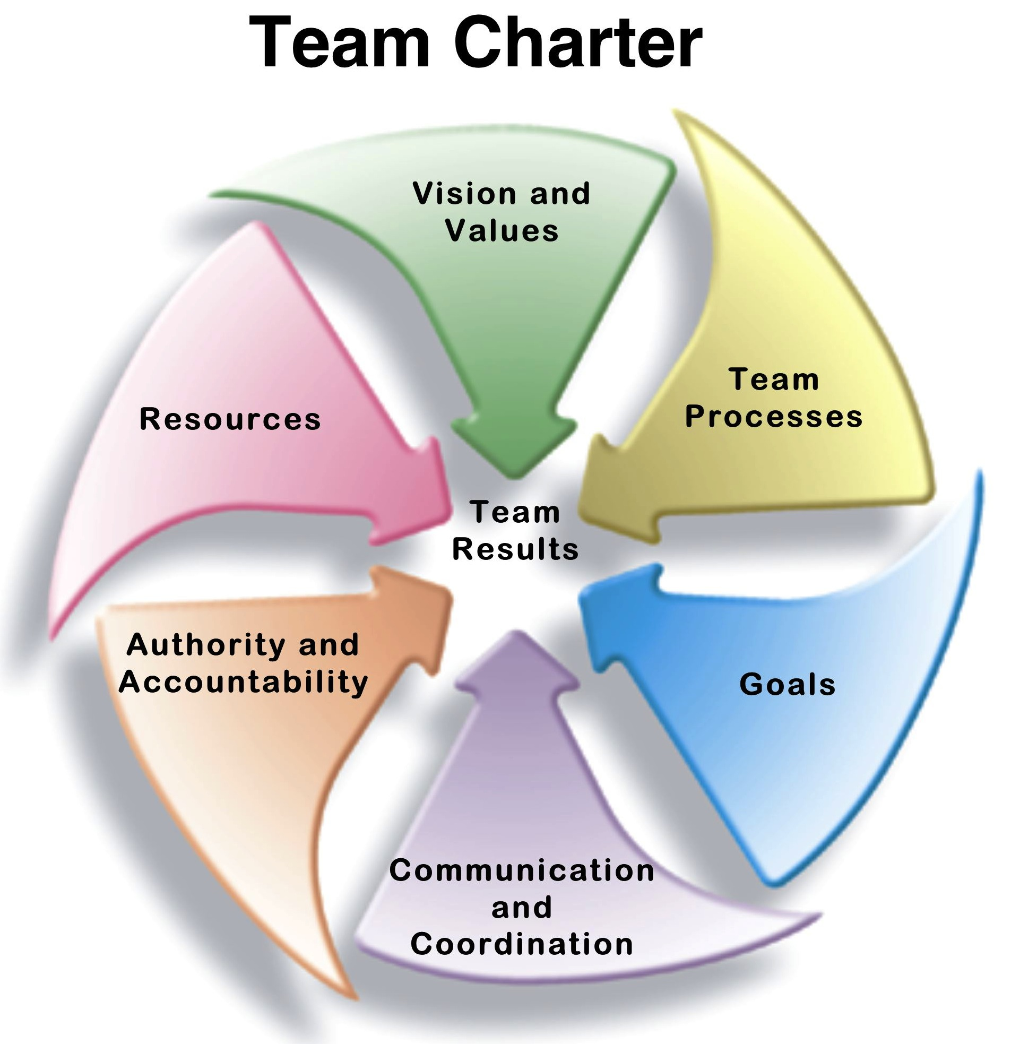
Project Charter

Slide 5
Project Charter
In project management a project charter is a statement of the scope, objectives, and participants in a project.
Clarifies who the customer and key stakeholders are
Ensures that the customers needs/wants are well defined and understood
Highlights what is trying to be accomplished…goals, milestones, etc.
Assures leadership is clear about expectations
Team members and clarification of roles
Notes:
The purpose of the project charter is to document:
Problem statement (what are your current metrics compared to goal)
Aim or goal statement
Reasons for undertaking the project
main stakeholders
In-scope and out-of-scope items (inclusion and exclusion criteria)
Communication plan
Target project benefits

Slide 6
Developing a Team Charter
The charter keeps the team aligned with the organization’s priorities
A document describing the improvement project- including problem definition, business case, project aim, project scope, team membership and project plan.
A signed document between the team and project sponsor detailing the specifics of the team and project.

Slide 7
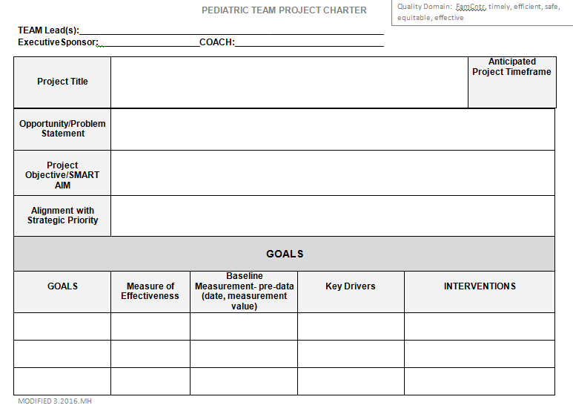

Slide 8
Criteria for a Successful Project
Have clear objectives. What is the problem or issue you want to improve? Be specific. Avoid “fuzziness”. Know the extent or impact of the problem or issue.
Narrow your focus. Avoid too broad a scope. Choose something that can be measured via percent, rate, number, etc.
It’s not a project if you already know the solution
Keep it simple. Avoid too many objectives
What will success look like? Make sure you have the ability to determine if success has been achieved
Speaking of success, are there metrics associated with process?

Slide 9

You cannot boil the ocean or solve world peace, at least right now
Example:
  Decrease the use of ceftriaxone in patients with community acquired pneumonia at CCMC by 30% by 6/1/2017 vs.
  Increase ampicillin use in patients with community acquired pneumonia in the inpatient unit cared for by the hospitalists at CCMC by 30% by 6/1/2017
Limit the scope of your project to one area or one set of patients, think small!
Avoid the temptation to implement a pilot

Slide 10

Aim Statement

Slide 11
  “Soon is not a time, some is not a number”
  –Don Berwick
  MD
Improvement aims cannot
be vague
Aim: written statement of the accomplishments expected from a team’s improvement effort.

Slide 12

Be S.M.A.R.T. when writing your
AIM statement
Specific (clearly stated)
Measurable (measurable numeric goals)
Actionable (within the control/influence of your team)
Relevant (aligned with the organization’s priorities)
Time bound (specific time frame)

Slide 13
Elements of a Good Aim Statement
A Smart Aim answers the questions of:
  What population?
  What will we increase or decrease?
  From what %/Rate, etc.
  To what %/Rate, etc.
  By When?

Slide 14
Aim Statement (what will success look like?)
Example:
The aim of this project is to decrease the rate of non-ICU CLABSI by 50% in Med3 and PAV3 patients by the end of 2017
This Aim Statement meets all of the S.M.A.R.T. criteria. It is:
Specific: States what it impacts, the goal and when it should be achieved
Measurable: Rate is one of the ways that we measure our performance
Actionable: CLABSI reduction is within everyone’s control and responsibility
Relevant: CLABSI reduction is relevant to CCMC’s performance metrics
Time bound: Success should be achieved by the end of 2017

Slide 15
What is an Example of a Well-written Aim Statement?
Change the length of time it takes for patients to be seen in the ED
Educate the PCAs as to how to enter vital signs in SCM to reduce the number of mistakes
Decrease from 23% to 0% the amount of T&S blood samples sent to the lab on the evening shift that are missing labels by Dec. 2017
What does the 3rd statement have that the others do not?

Slide 16


Aim Statement – Choosing your Population
Think of your project as an empty picture frame. You’re going to fill your frame with what the team feels is within the scope of the project (inclusion criteria). Outside of your frame are the elements that are not within the scope of your project (exclusion criteria.)
Remember…you can’t take it all on or you may not be successful…you can’t boil the ocean, at least not yet
Laminectomy patients
Intubated patients
Patients at risk for DVT
Patients unable to walk
Patients with pneumonia
Patients in which walking is contraindicated
Infants
Project example: Increasing early ambulation of patients post-laminectomy in PICU

Slide 17


Key Driver Diagram

Slide 18

Key Driver Diagram
A key driver is something that has a big impact on whether your aim can be accomplished

Slide 19
A Key Driver Diagram
Organizes the improvement for your project
Connects the aim/ outcome, key drivers, and interventions (change concepts)
Helps to focus the selection of changes to test by identifying the key drivers
Serves as a communication tool to present your work

Slide 20
Tools to Develop your Key Driver Diagram
    Brainstorming
          Enables people to suggest ideas at random
          Allows everyone’s voice to be heard
          Don’t dismiss ideas, no matter how “out there”
          Group activity
          Discourage others from criticizing
      Fishbone Diagram
      Review of literature
      Key stakeholder discussions, etc

Slide 21


My little chefs…

Slide 22
Let’s Build a KDD….
Secondary Drivers
2 cups flour
Primary Drivers
1 cup chocolate
1 tbsp baking powder
Ingredients
1 stick butter
1 cup sugar
AIM
Preheat
Oven (baking)
350 degrees
Bake a chocolate cake with icing in <2 hours
35 minutes
Keep closed
Utensils
(2) 8” round metal pans
Spatula
Electric mixer (med speed)
(2) metal racks
Assembly
Cooled layers (minimum 1 hour)
Cake plate
Icing

Slide 23
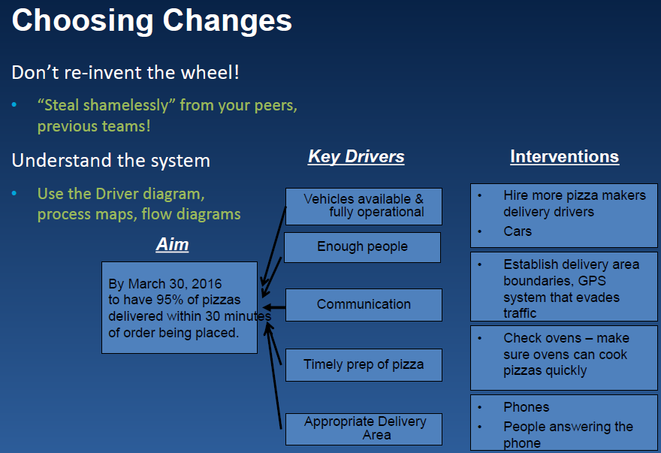

Slide 24
Performed on admission
Routine
Subsequently every 12 hours
Assessment
Document in A&I>Skin
RN and RT concurrently
Bi-PAP
Start of shift and every 4 hours
Pressure relief
Lift Mepilex Lite
Document in A&I>NPPV/C-PAP
Gel mask usage
Skin cleaned
Mask protocol
Correct fit (3 sizes)
Cavilon applied
To decrease the rate of device-related pressure ulcers in PICU caused by bi-PAP masks from 3.74 to 1.87 (50%) by 12/31/15
Clean mask every shift and prn
Mask adjusted
2-finger rule
Air leak presence
Barrier device
Cavilon to nasal bridge
Reapply @ every barrier change
Dry for 30 seconds
Mepilex Lite to area under mask (template)
Clean skin every 4 hours
Skin care
Reduce moisture/bacteria buildup
Monitor for redness
Skin care champions/MD/RN

Slide 25
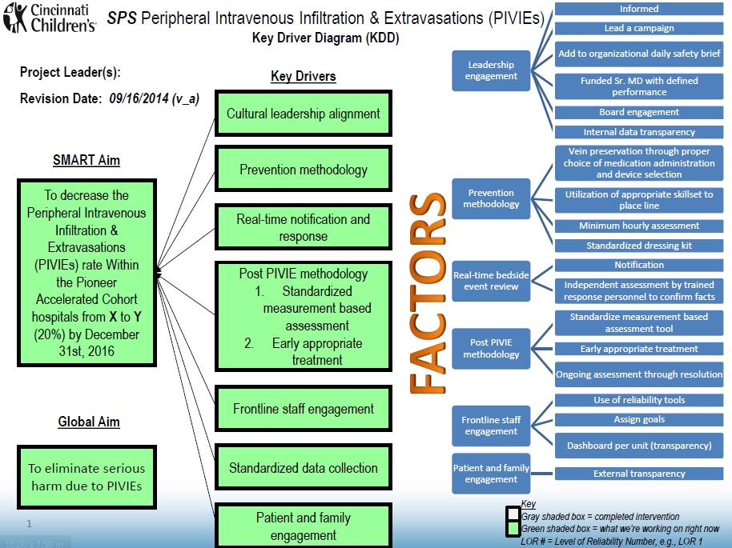
How to get from a KDD to PDSA cycles
You’ve stated your problem, developed your SMART aim, and determined your key drivers….now what??
Determine which driver you are going to target first.
        Prioritize
Pareto chart
Control Impact Matrix

Slide 26
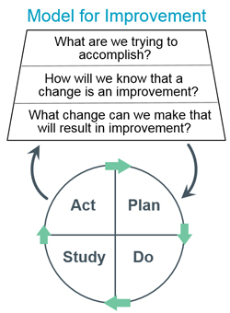
PDSA Cycles
The best way to know if a change will work is through testing
A small test of change will show if changing one piece of the system has an effect on your outcome
Testing is done using multiple PDSA cycles
PLAN-Develop a change
DO- Testing a change
STUDY- Analyze and interpret results of your
Test of change
ACT- Decide what to do next

Slide 27
PDSA Comparison: PDSA vs. Pilot
PDSA Phase | Pilot → Implementation Phase
PEOPLE: Few Number of people affected is small, and resistance to change is low. | PEOPLE: Many Number of people affected is relatively large, may be stronger resistance to change.
SUPPORT NEEDED: Low Testers do not intend changes to be permanent and therefore do not need processes to maintain changes. | SUPPORT NEEDED: High Testers expect change to become routine operation, supporting processes to maintain change must be in place.
TIME: Shorter Cycles for testing changes can be rapid. | TIME: Longer Pilots and implementation requires more time.
TOLERANCE FOR FAILURE: High It’s OK and encouraged for testers to learn from mistakes – failure is important opportunity to learn. | TOLERANCE FOR FAILURE: Low Tolerance for failure is low, there must be high confidence that changes will result in an improvement.

Slide 28
PIVIE Reduction HAC Key Driver Diagram

Slide 29
PLAN
Plan your test of change, including a plan for data collection
State the objective of the test
Make predictions about what will happen
Develop a plan for the test (Who? What? When? Where? What data needs to be collected?)
Objective: To improve knowledge/efficiency of comprehensive assessment for PIVIE
Plan: Give bedside nurse job-instruction sheet regarding how to assess for an IV infiltrate
Measures: Percent of IV assessments that are complete, time it takes to do an assessment, increased number of assessments/opportunities for assessment
Prediction: Job instruction will increase percentage of IV assessments that are complete, decrease time it takes to complete assessment and increase percentage of required assessments that are performed

Slide 30
DO
Try test out on a small scale (1 patient with 1 RN)
Was the test carried out as planned?
Record outcomes
Describe any unexpected outcomes
Do: RN on PAV 3 given job instruction sheet
Job instruction sheet given at brief, but RN did not have time to read until after 9am medication delivery
RN interrupted a few times while reading job instruction sheet
During first assessment RN referred to job instruction sheet, but had to pull out of pocket and instruction sheet tore

Slide 31
STUDY
Analyze the collected data and study the results
Look at different aspects of your test (look at they system as well as the tool)
Compare data to what was predicted
Summarize and reflect on what was learned
Quantitative Measures: 10/10 assessments done included all elements, average time to complete assessment 4 min (range 2-8 min), assessments/opportunities 10/15
Qualitative Measures: Nurse noted difficulty when patient was sleeping, and lights were off, parent did not want to be disturbed

Slide 32
ACT
Based on your study of your test, refine the change and make modifications
Prepare a plan for the next test
                A – Adopt – Adopt the change to a larger scale
                C – Change – Change or refine the test of change and continue testing before scaling up
                T – Trash – Trash or abandon the test of change and move on to the next test
C-Change: Do in-person job instruction right after brief using train-the-trainer model
C-Change: Give RNs min-flashlights to do assessments while patient sleeping
C-Change: Family engagement/education regarding expectations of hourly IV assessments

Slide 33
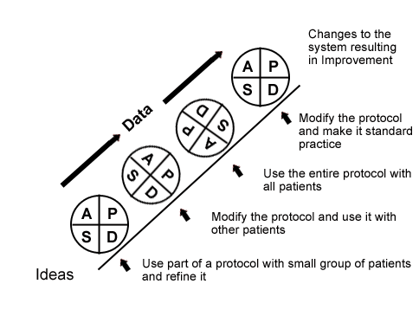
Ramping up for Improvement & Change
PDSA cycles must be linked

Slide 34
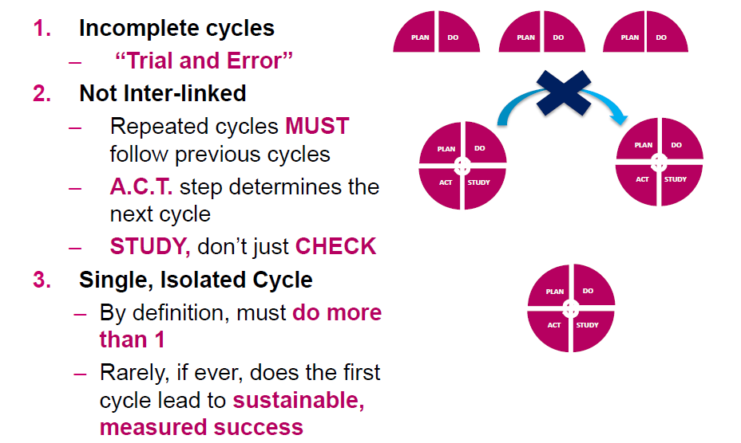
Common PDSA pitfalls

Slide 35

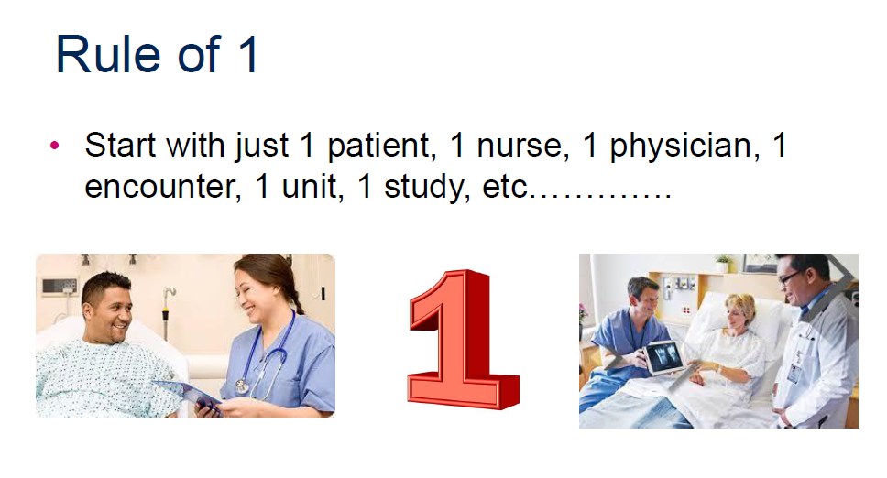
Start Small….

Slide 36

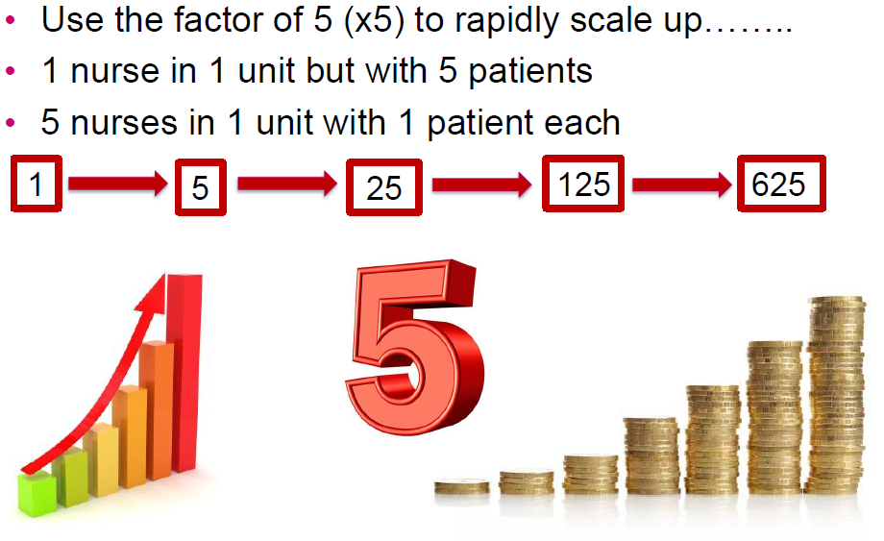
But Scale Up Fast….

Slide 37
Family of Measures
Outcome Measures: Relates to your problem statement and aim statement
    Number of moderate-severe PIVIE/patient days
Process Measures: Steps in the system
    Number of complete hourly assessments done/opportunities
Balancing Measures: Are changes designed to improvement the system causing problems in another system?
    Time to do assessments
    Patient satisfaction

Slide 38
Run Charts and Control Charts
Run charts show progress over time
Useful for determining trends or patterns in a process
Visually show how well (or poorly) a process is performing
Need around 10 data points
Plot the median
Control charts show how a system is performing within the upper and lower specification limits as well as with the average
Control charts are plotted over time
Need at least 15 data points, preferably 20
Plot the mean
Plot the UCL/LCL

Slide 39
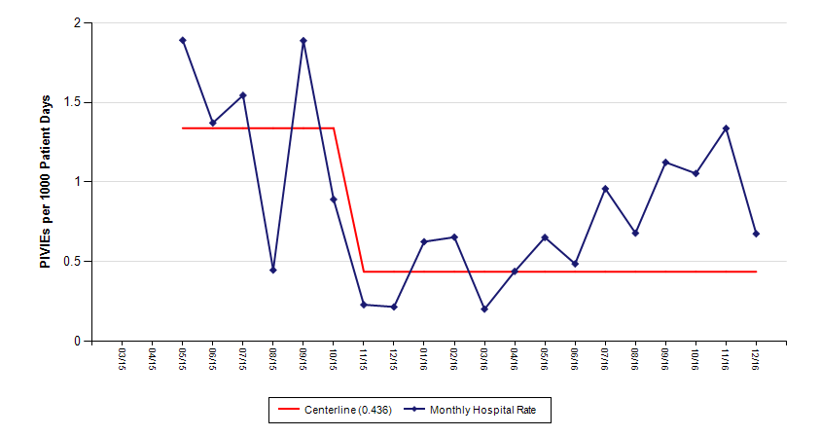
Run Chart - PIVIE

Slide 40
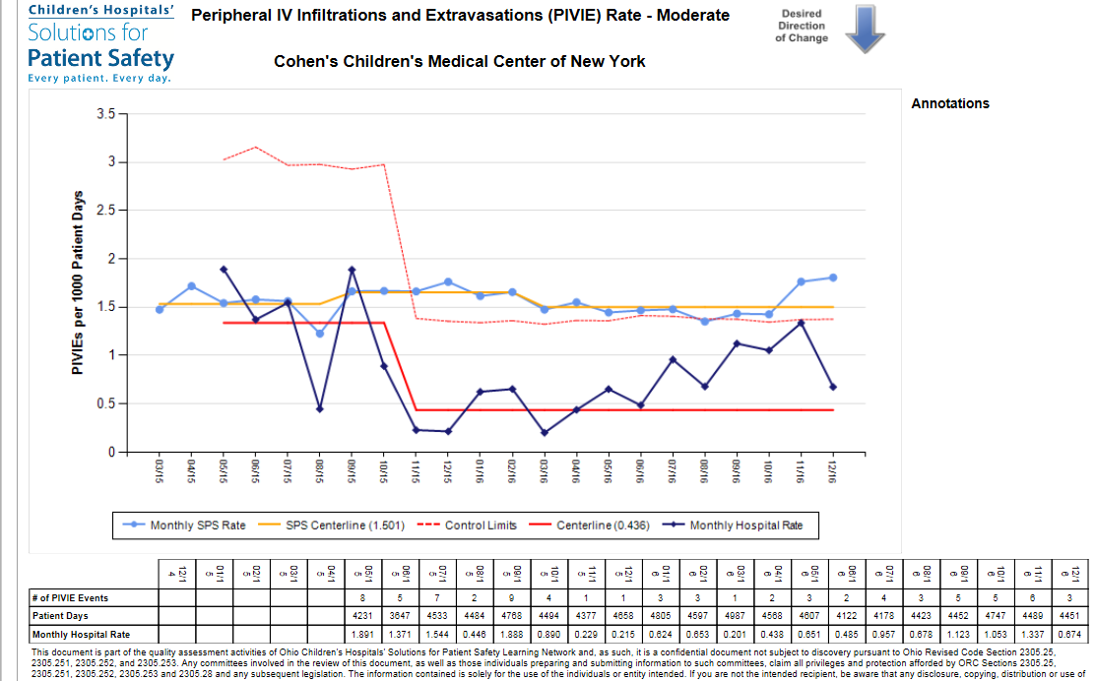

Slide 41
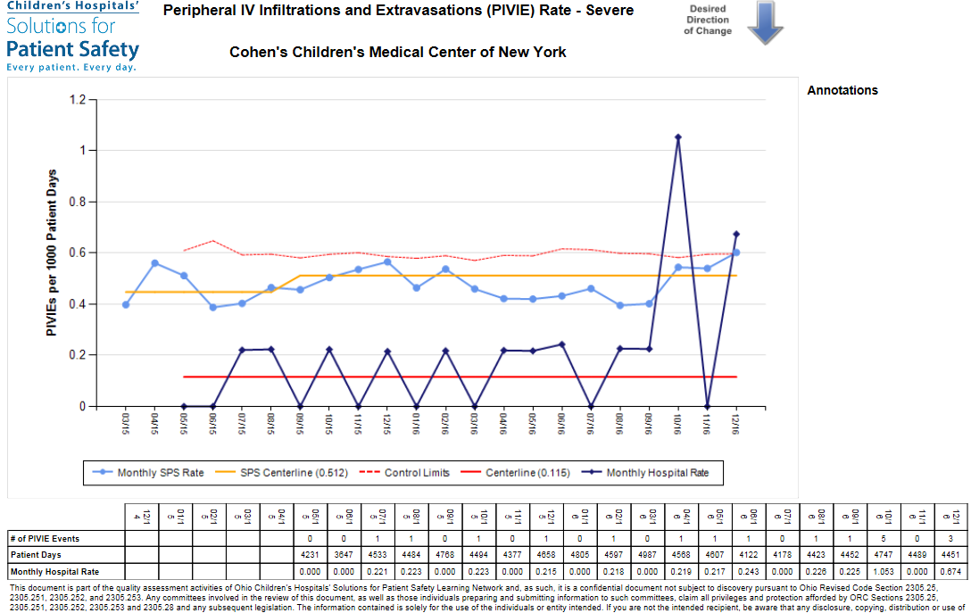

Slide 42
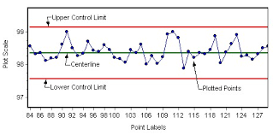
Control Chart Analysis - BASICS
Common cause variation: Within the control limits
Special cause variation: 1 data point above/below control limits
Shift: 8 or more number of data points above/below centerline
Trend: 6 or more data points constantly going up, or constantly going down

Slide 43
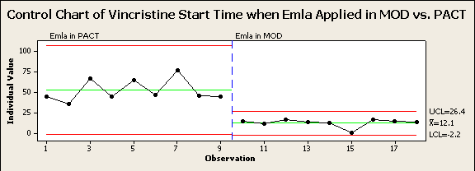
P Project: PACT Vincristine Start Time
A Control Chart shows if there is any special cause variation in a process and if the process is in control via lower and upper control limits.
This is an example of the use of a Control Chart to show the Vincristine start time when Emla cream is applied in PACT vs. when it is applied in the Hem/Onc MOD
X = 56 minutes

Slide 44
Implementing and Sustaining Change
Implementing Change
After testing a change on a small scale, learning from each test, and refining the change through several PDSA cycles, the team may implement the change on a broader scale —for an entire pilot population or on an entire unit
Spreading Change
After successful implementation of a change or group of changes for a pilot population or an entire unit, consider spreading the changes to other parts of the organization

Slide 45
Thank You

